Slide 1
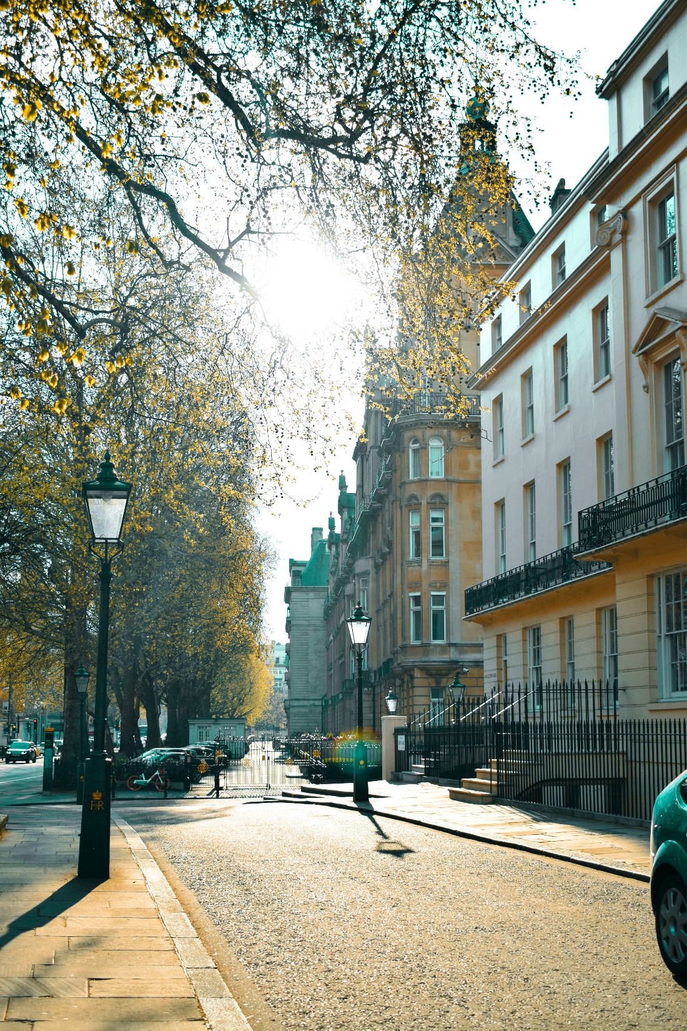
Hospitality Management
Presentation 2
By: Pardis, Jesu, Khalid, & Nusayba

Slide 2
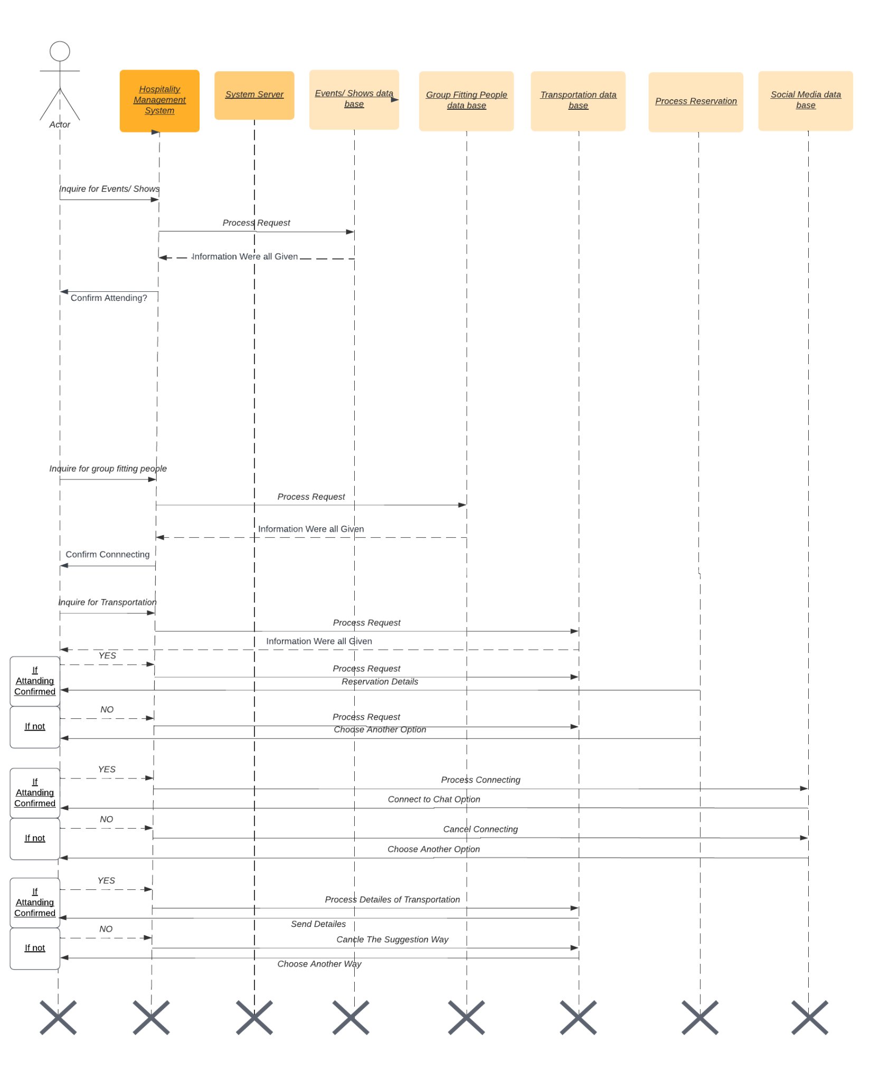
Diagram
Sequence Diagram
UML 1
UML 2

Slide 3
Diagram
Sequence Diagram
UML 1
UML 2

Slide 4
Diagram
Sequence Diagram
UML 1
UML 2

Slide 5
Diagram
Sequence Diagram
UML 1
UML 2

Slide 6
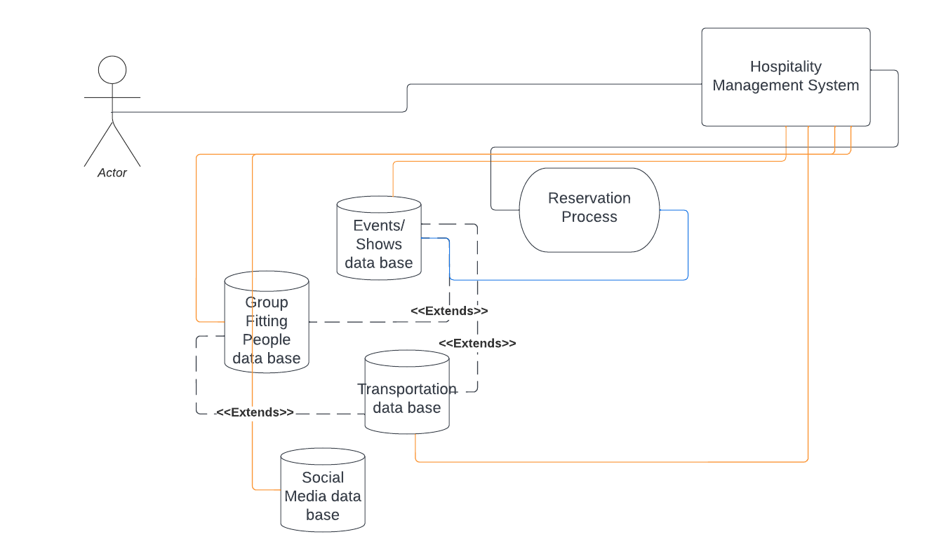
Sender
Diagram
Sequence Diagram
Use Case Diagram 1
Use Case Diagram 2

Slide 7
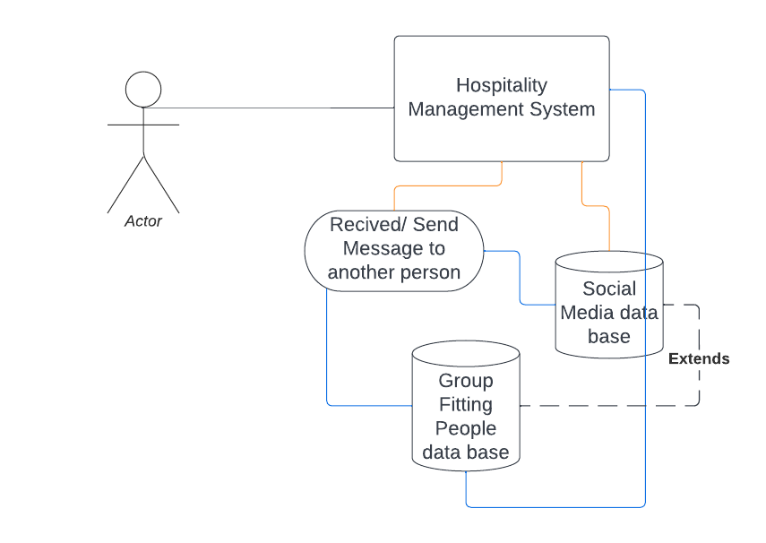
Receiver
Diagram
Sequence Diagram
Use Case Diagram 1
Use Case Diagram 2

Slide 8
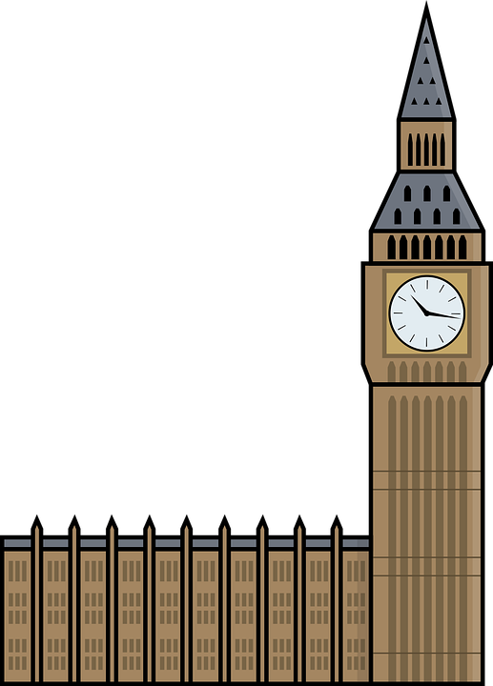
Test Scenario 1
Input | Test | Expected Output
Add several dummy accounts to the Group Fitting database. Have them match to the true users characteristics to various extents. | Verify the users with similar features are connected while making sure that multiple features are similar between user before matching | Only have dummy accounts that match on critical characteristics(location, age, time…) match
Notes:
An important feature that users will have is being able to be connected with other users that have similar interests or happen to be attending the same events as the other users. With this, it allows the system to group the users with similar features that they share.

Slide 9
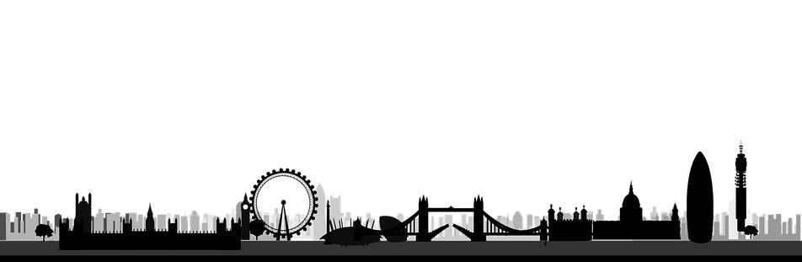
Test Scenario 2
Input | Test | Expected Output
Add events from multiple cities and different times to Events database. Act as a users in certain city. | Verify that the events tab appropriately updates and filters out irrelevant events so that user only view geographically and chronologically relevant events. | Only events from current city populate the events tab
Notes:
One of our main features is the ability for the user to view events that are going on in the city
For this to work an intended, only events that are stored in our database that are relevant to the user will be displayed.
In this scenario, if you were the user, you would want events that are filtered to your needs meaning in proximity, time, location, relevance.

Slide 10
Thank you for listening!

